Slide 1
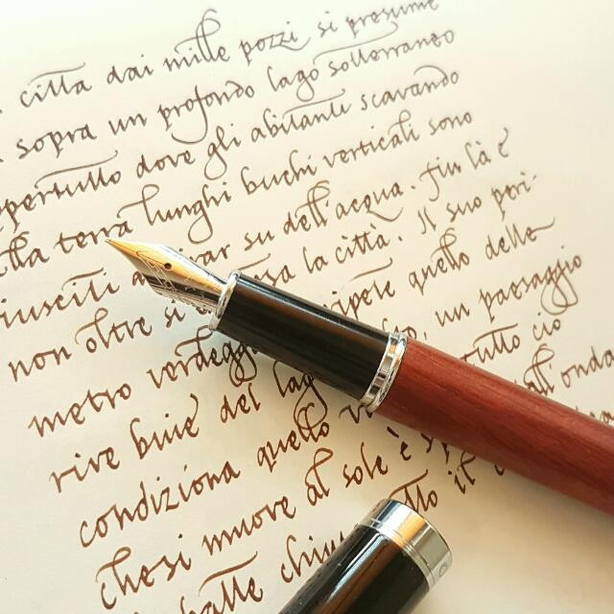
Whether recognition of handwriting will be correct?
Whether my input data is correct?
Whether it satisfies the user's needs?
Search for the apt input data
Train the model to get accurate results
Develop the UI so that people can work easily
Predicition Results
Ability to recognize the contents of the image
Upload the testing data (i.e) Image of handwriting
Desired output from the model based on the input (i.e) image
Training the model to get the correct output
Working with neural network to get the correct word as written
Gettting the correct output based on the training data of the model
Detection of words in the handwritten format will be done in the faster way

